Slide 1
Big Mountain Pricing and Future Improvement Strategy

Slide 2
Scope of the Business Problem
Big Mountain has recently installed a new chair lift increasing operational cost by $1.54 million
Possible Solutions posed by Big Mountain
Increase ticket prices
Closing down up to 10 runs
Increase vertical drop by 150 feet by installing a new chair lift
Increase vertical drop as above and adding 2 more acres of snow making cover
Increase longest run by .2 miles requiring 4 more acres of snow making cover

Slide 3
Recommendation and Key Findings
Increase ticket prices by $10-12
For its facilities Big Mountain is underpriced.
Close down at least one run, possibly more depending on their operational cost
Closing down one run will not affect your modelled ticket price
Closing down more will affect modelled ticket price, but you can compare this against operational costs
Other improvements did not affect modelled ticket price and are not recommended

Slide 4
Modelling of Ticket Price
The features that most contribute to the ticket price of comparable resorts are number of runs, fast quads, vertical drop, and total chairs
Big Mountain does have the highest ticket price in Montana
However, Big Mountain also has better features than most resorts in the comparable market
What does this mean for ticket price?
Using a Random Forest Model that was chosen due to superior performance to other models, Big Mountain’s ticket price was predicted to be ~ $93
Big Mountain’s ticket price is currently underpriced by about $12 compared to similar resorts

Slide 5
Closing Runs
Closing at least one run is recommended as closing one run would not affect the modelled ticket price
Closing two or three runs would each affect the modelled ticket price significantly
If three runs were closed, you might as well close five as there is little difference in the ticket price between these options.
Closing a sixth run would again significantly affect the modelled ticket price, but there isn’t a significant difference between closing more runs up to ten.
The graphs on the following slide give a visual summary

Slide 6
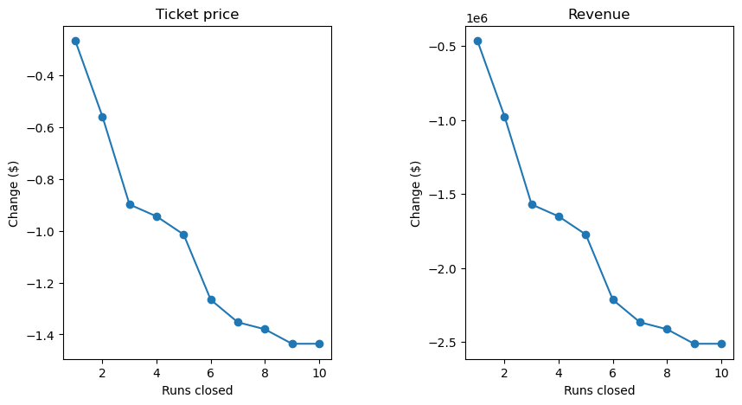

Slide 7
Improvements under Consideration
Increasing vertical drop by 150 feet by adding chair lift
Not recommended, this only increases modelled price by <$1
Increasing vertical drop by 150 feet by adding chair lift and adding 2 acres of snow making
Not recommended, makes no difference to the modelled price as compared to the above
Increasing longest run by .2 miles and adding 4 acres of snow making
Not recommended, makes no difference to modelled price

Slide 8
Summary
To recoup the 1.54 million in operational costs from the new lift I recommend the following courses of action
Increase ticket price to desired amount. My analysis provides support for an increase of $10-12
Close at least one run
Close more runs as justified by operational costs compared to increase in ticket price
None of the proposed improvements are recommended as they do not significantly affect modelled ticket price

